Slide 1
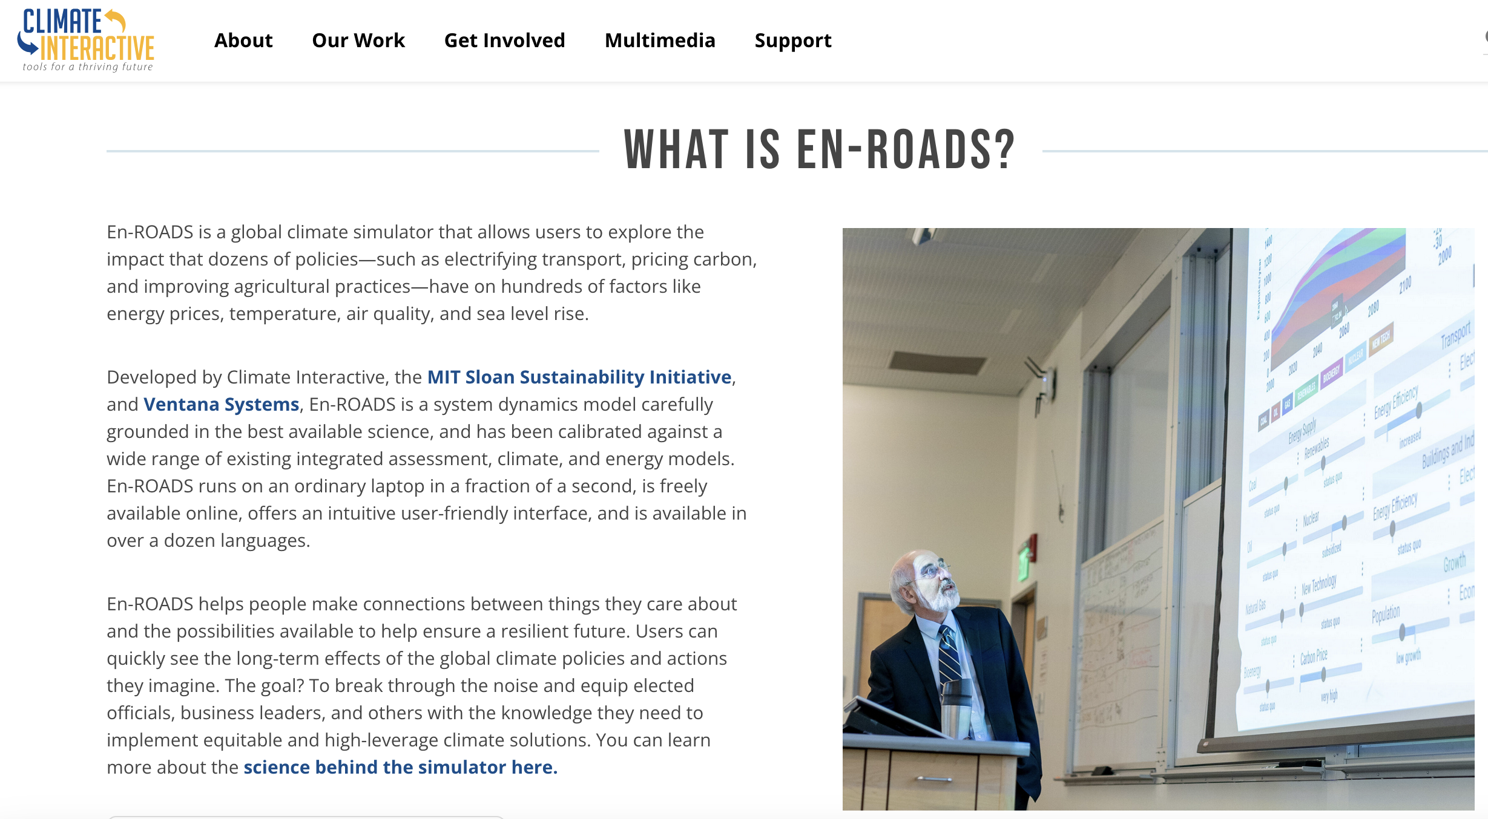
EnROADS

Slide 2
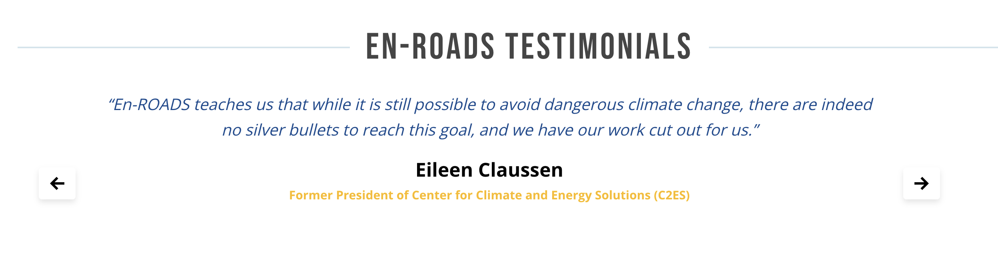
EnROADS

Slide 3
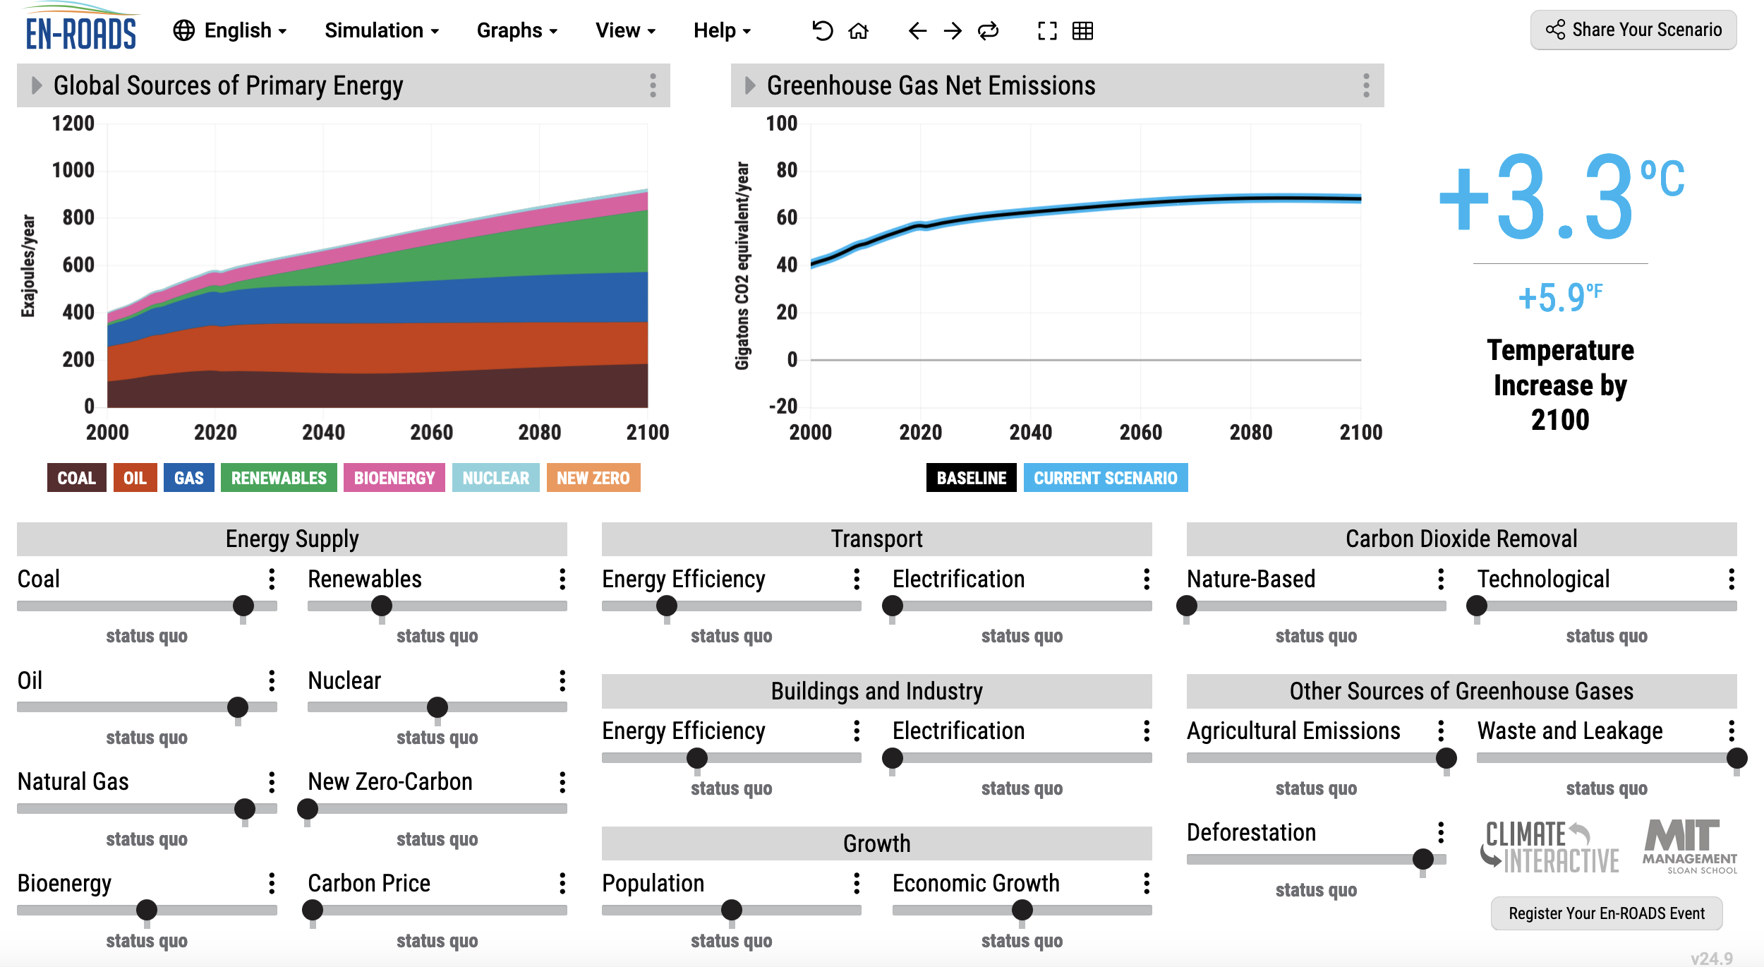
OK, let’s get started
Your goal …
Adjust sliders such that we emit as much as we possibly can, but still stay (barely) under 2 degrees warming.
Share the link to your Scenario on your research notebook.
Critique your scenario (Is it politically realistic? Is the science right?)

